Slide 1
GÉANT & Regional Networks – An Update
ALICE2 Meeting
Cuenca, Ecuador
15th-16th November 2012
Tom Fryer, DANTE

Slide 2
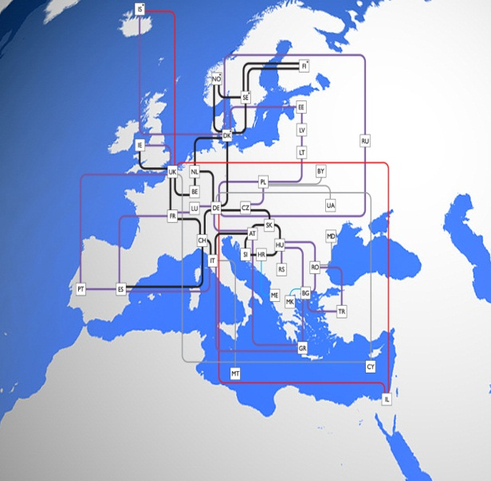
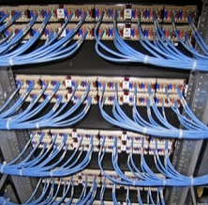



The GÉANT Network:
A little more detail
50,000km network infrastructure on
44 routes
25 European POPs
Diversified footprint
Serves 40 million users
8,000 institutions
Across 40 European
countries
12,000km of dark fibre on 18 routes
GÉANT is co-funded by Europe’s NRENs and the European Commission (EC) under the Seventh Framework Programme (FP7)
Project Partners are 32 European NRENs, TERENA and DANTE
150 FTEs’ annual effort (> 350 individuals) working in GÉANT
across Europe

Slide 3
GÉANT Network Equipment Procurement
Lot 1 changes
Replaces GÉANT Lambda service
100Gbps and 40Gbps wavelengths
Multiplexed 10Gbps wavelengths
No native individual 10Gbps wavelengths
Migration from 1626 Alcatel Light Managers to Infinera XTC-10 and Infinera OTC
Lot 2 Changes
Places IP and GÉANT Plus circuits on a common platform
Up to 100Gbps
No capacity granularity limits
Ability to statistically multiplex capacity
Migration from Alcatel MCC to Juniper Mx 960
Notes:
Message = what will do to move usage forward
NEED TO ADD MORE

Slide 4
The GÉANT Equipment Migration
  2 New Routes
  5 Parallels Routes
  35 juniper Switches to install
  112 Infinera equipment to install
  220 Alcatel equipment to remove
  170 sites to visit
  10 months to complete!

Slide 5
GEANTPlus – Lot 2
Migration Stages
Tallinn
Riga
Dublin
Tallinn
Riga
Dublin
Copenhagen
Copenhagen
Stage 1
Stage 4
Moscow
London
Moscow
London
Amsterdam
Amsterdam
Kaunas
Kaunas
Brussels
Brussels
Poznan
Poznan
MANLAN
Frankfurt
Luxembourg
Frankfurt
Prague
Luxembourg
Prague
Paris
Geneva
Paris
Geneva
Vienna
Bratislava
Vienna
Bratislava
Lisbon
Stage 2
Lisbon
Stage 3
Budapest
Budapest
Ljubljana
Zagreb
Milan
Ljubljana
Zagreb
Milan
Madrid
Madrid
2
Athens
Athens

Slide 6

GEANT Plus Coverage
EE
LV
LT
LV
PL
DK
EE
PL
DK
LT
RU
RU
100%
75%
BE
This means:
Bandwidth on Demand Available to everyone thanks to GEANT Plus
IE
UK
BE
UK
NL
NL
DE
DE
CZ
CZ
SK
IE
SK
LU
LU
GEANT Plus now offers full coverage
giving access to GEANT Plus to
ALL NRENs
GEANT Plus was covering only 75% of
the GEANT footprint
RO
FR
RO
FR
CH
CH
AT
AT
HU
HU
Fink
BG
PT
ES
IT
SI
HR
BG
PT
ES
IT
SI
HR
KEY
GR
GR
Dark Fibre
Nx10G leased lambdas

Slide 7
Where are we now?

Slide 8
Today: MX installation
80%

Slide 9
Today: GEANT Plus Circuits
80%

Slide 10
Trunk Migration
40%

Slide 11
Almost done!

Slide 12
What is left?
6 Mx routers
12 Geant Plus Circuits
18 Trunk

Slide 13
Outage analysis
Complex auto negotiation issues
Faulty barrel connector on patch panel
Planned outage 60 min
Average Service outage:
10min 20 sec
Services Migrated
Scheduled down time
Average Measured
Actual Service impact

Slide 14

A lot of travel
Our Vendor installation team travelled about 25,000 Km
  2½ times the circumference of the moon
  Over half-way around the globe
  The distance we have covered to reach Cuenca

Slide 15
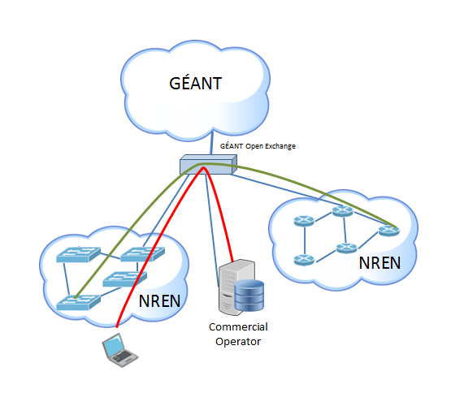
GÉANT Open – new pilot project
Background
Initial 1 year pilot to test “Open Exchange” concept within GÉANT
Based in London at a major telehouse
Facilitates interconnections of Research & Education users
Enables interregional connections + other connections to GÉANT domain

Slide 16
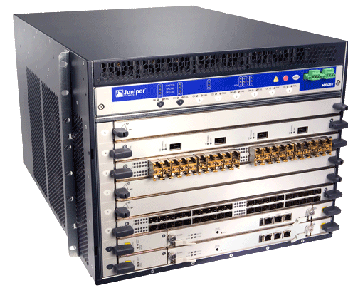
GÉANT Open – new pilot project
Pilot
Allows NRENs and Commercial organisations to try out the concept
Designed to offer neutral, policy free interconnection facility – and onward connection to GÉANT network
Layer 2 interconnection services are available on a Juniper MX Series
Connection speeds from 1Gbps (€3,300) – 10Gbps (€10,500)
Current Status
Launched 1st October 2012
First connectors NORDUnet and SURFnet
Website: www.geantopen.net

Slide 17



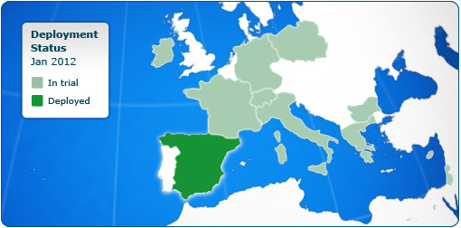






perfSONAR MDM adoption
13 NRENs (+GEANT Backbone) evaluating/implementing the perfSONAR MDM service for their NOC/PERT engineers.
Second group of 8 NRENs now targeted → More NRENs will join the pilot
Liaising with other communities outside EU:
  TEIN, RedCLARA, GISELA, …

Slide 18
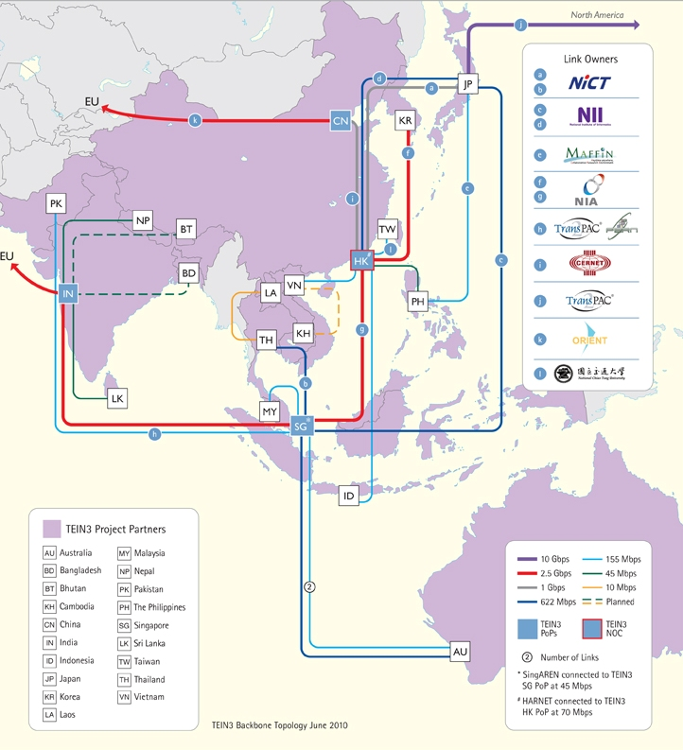
perfSONAR MDM deployment in Asia/Pacific
3 Measurement Points within TEIN3:
  Singapore
  Hong Kong
  Beijing
Already available in the current perfSONAR MDM UI

Slide 19
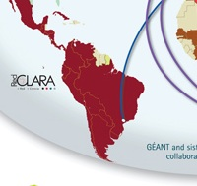
perfSONAR MDM deployment in Latin America
Active collaboration with network and grid community
Liaising with RedCLARA
Liaising with GISELA
5 Measurement points:
  CEDIA (Ecuador)
  RAAP (Perú)
  RNP (Brazil)
  REUNA (Chile)
  RAU (Uruguay)
Already available in the current
perfSONAR MDM UI

Slide 20
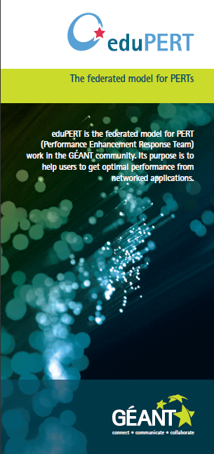



eduPERT
Perfomance U!
eduPERT is an open community to all interested in performance issues.
The main goal is to disseminate performance expertise among NRENs, projects and campus. A big and strong community sharing knowledge and experience. A “Performance U!”niversity for everybody.
Goes beyond the network. An extended field of action moving towards the end user and the end point, including positioning for new technologies such as cloud which increase the complexity of performance understanding and diagnosis.

Slide 21
Beyond GN3: GN3+
GN3 is a four-year project due to end in March 2012, extended for six months
Follow-up project is entitled GN3+
GN3+ starts in April 2013 and will last 2 years
Proposed structure similar to GN3
Final proposal for EC in preparation – to be submitted in December 2012
Activity Leaders have been appointed. Task Leaders to be appointed soon

Slide 22
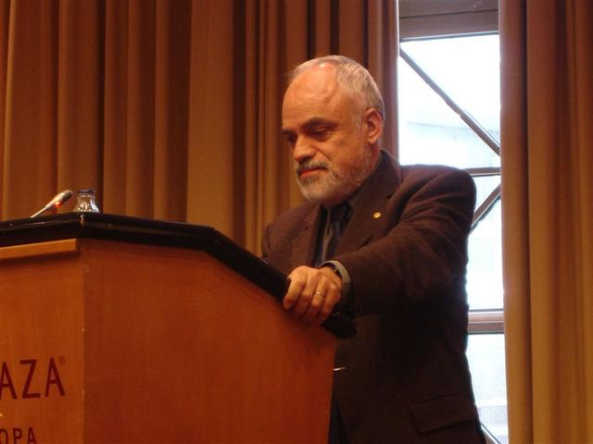
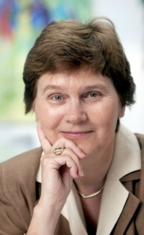
GÉANT NREN PC Chairperson
Vasilis Maglaris has stepped down as NREN PC Chair.
On 26th September, Dorte Olesen was elected as new NREN PC Chair.
Dorte is from the Technical University of Denmark, and has held high profile roles such as president of TERENA (2003-9) and most recently in 2011 was part of the high level independent GÉANT Expert Group (GEG)
Notes:
22

Slide 23
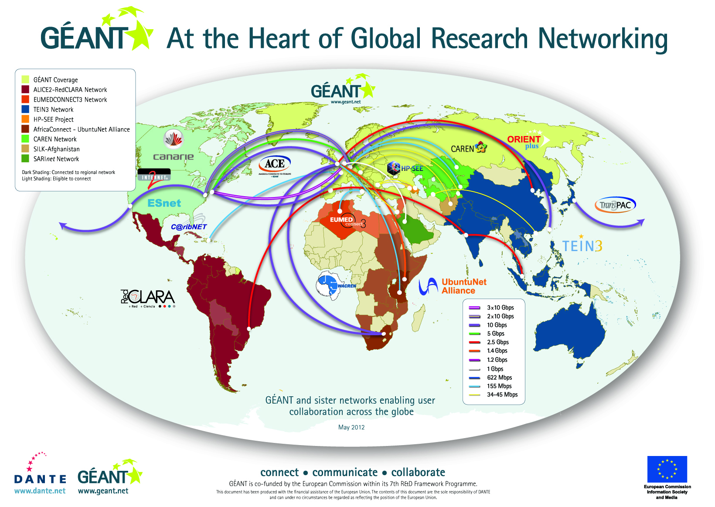
GÉANT: Global Reach
GÉANT connects to 62 countries outside Europe
http://global.geant.net/

Slide 24
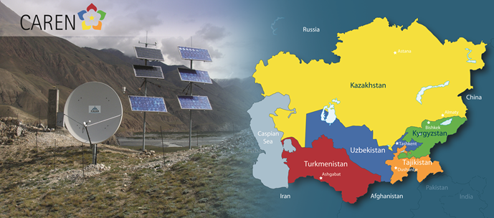

Central Asia:
CAREN (Central Asia Research and Education Network
First Central Asian R&E network:
  Kazakhstan 155 Mbps
  Kyrgyzstan 155Mbps
  Tajikistan & Turkmenistan in service at 34 Mbps
Hubs in Frankfurt and Hong Kong
Managed by DANTE with contracted assistance from University of Groningen and a regional co-ordinator based in Kyrgyzstan
Project was to end in Dec 2012, now extended to June 2013
Bid to be made for additional funding up to mid-2014 and then there is expected to be a bid for a new 4-year project
http://caren.dante.net
Notes:
Shining example of collaboration between multiple countries which is working –
Fostering global collab
Reinforce message of ERA

Slide 25

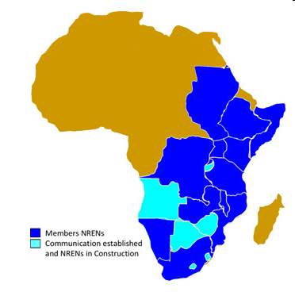
Sub-Saharan Africa:
AfricaConnect
4-year project from May 2011
  Planning and Procurement (current phase)
  Operational Phase (from late 2012 / early 2013)
Total Budget of 15 M Euro (divided in 80:20)
Partners:
  UbuntuNet Alliance – www.ubuntunet.net
  UbuntuNet Alliance member NRENs
  WACREN and Association of African Universities
  DFN, GARR, FCCN, HEANET and SURFnet
  DANTE as the Coordinating Partner
Project Launch taking place in Dar es Salaam, Tanzania, this week and in Lisbon, Portugal, on 28th & 29th November
Implementation of eduroam in Sub-Saharan Africa being discussed this week in Dar es Salaam.
www.africaconnect.eu
Notes:
25

Slide 26

North Africa and Middle East
EUMEDCONNECT3
Regional network since 2004
Work to re-build the network underway:
  Algeria – recently upgraded to 622 Mbps
  Palestine – 45 Mbps
  Egypt to reconnect in the near future.
EUMEDCONNECT3 2011 – 2014
3.3M Euro, 36% EC funding
Managed by DANTE with support of NRENs from Cyprus, France, Greece, Italy and Spain
e-AGE Conference to be held in Dubai in December
www.eumedconnect3.net
Notes:
Shining example of collaboration between multiple countries which is working –
Fostering global collab
Reinforce message of ERA

Slide 27
Asia-Pacific
TEIN4 and ORIENTplus
TEIN3 formally completed in September 2012
  TEIN4 to be managed by Korea-based not-for-profit organisation TEIN* Co-operation Center
  TEIN4 contract signed between EC and TEIN*CC to last from April 2012 until 2016
  8 M Euro, 50% EC funding support
DANTE has assisted TEIN*CC with tendering new TEIN4 network capacity and with project preparations.
DANTE subcontract has been signed to provide on-going support for TEIN*CC, e.g. procurement and implementation, audit preparation, marketing.
ORIENTPlus link from Beijing to Europe to be upgraded to 10Gbps

Slide 28
GÉANT-RedCLARA Cost Share after ALICE2
In January 2012 all ALICE2 funding ends.
A RedCLARA request has been made to the GÉANT NREN PC for a 50-50 cost share arrangement on the current direct interconnection between Sao Paulo and Madrid.
In a first discussion on 26th September, the NREN PC asked for more detailed information on all cost for all GÉANT-RedCLARA peering options.
This information is now gathered and will be presented at an NREN PC meeting on 26th November.

Slide 29
School Collaborations
Some NRENs connect K12 (primary & secondary schools)
Work on-going to create school collaborations case study
No current well-known global facility to enable teachers to find other teachers/schools/classes for collaborations
An initial discussion was held involving NRENs and other organisations from Africa, Europe, Latin America, Canada and the US in September.
A number of platforms have been identified and there is a proposal for a global community of NRENs and similar organisations to share experiences and ideas.
If your NREN is interested in participating please confirm to Tom Fryer

Slide 30
Anniversaries
CLARA celebrates its tenth birthday in 2013
DANTE celebrates its 20th birthday in 2013
THANK YOU

