Slide 1
FIWARE: Value proposition for Smart Cities
Jose Gonzalez
FIWARE Expert
jge@gatv.srr.upm.es
Federico Alvarez
FIWARE Expert
fag@gatv.srr.upm.es
http://www.fiware.org
http://lab.fiware.org
Follow @FIWARE on Twitter!

Slide 2
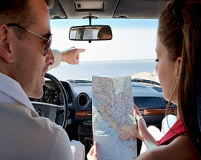
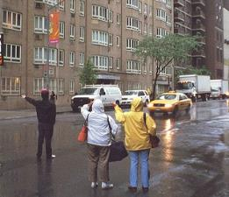

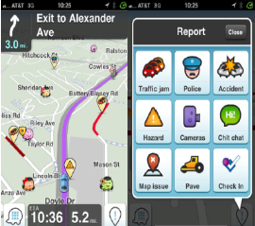
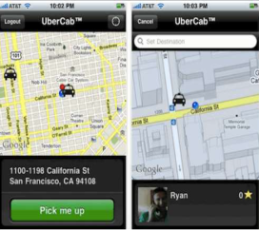
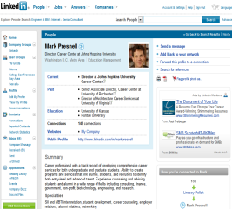
Internet: a transformation engine
Navigation, Calling a taxi (Uber), Recruiting (Linkedin)…

Slide 3


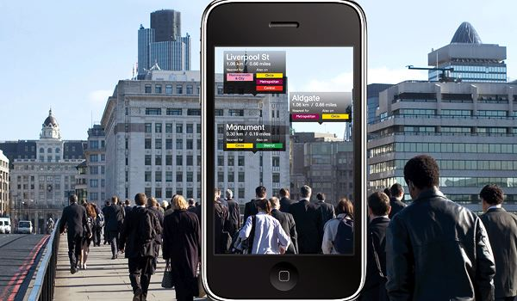
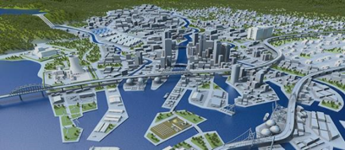



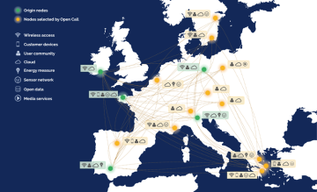
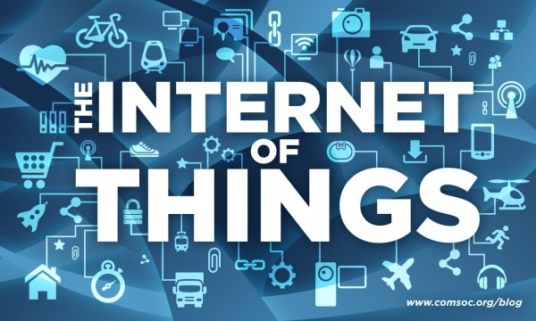
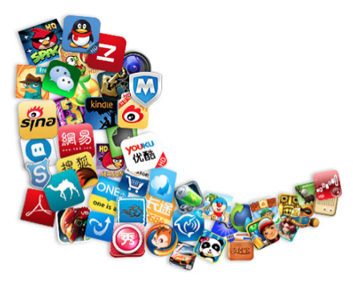



Understanding FIWARE (Open Standard Platform)
(advanced OpenStack-based Cloud + rich library of Generic Enablers)
Driven by implementation
Sustainability ensured

Slide 4
How can the new opportunities be captured and ultimately translated into local economy growth and creation of jobs?
Build
an
ecosystem
open
sustainable
global

Slide 5









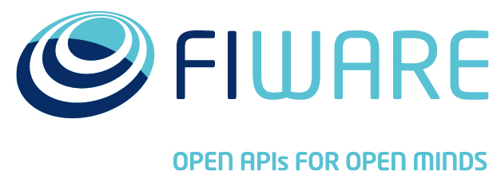


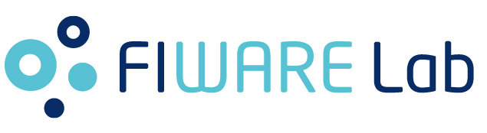
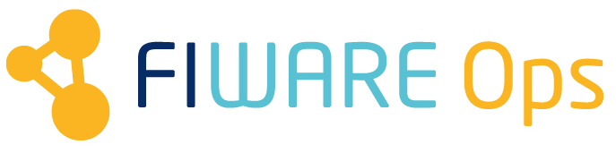
The Pillars of the Ecosystem

Slide 6
FIWARE Platform in a nutshell
What is it? Cloud hosting capabilities + rich number of added-value functions offered “as a Service”
Thus, it is an open alternative to existing proprietary Internet platforms (Amazon or Google), enabling an easy development of Future Internet applications
ICT Smart Communities will be able to:
  Choose the provider where to deploy apps to deal with Smart City services
  Obtain Open Data from such environment in a standard and easy manner

Slide 7
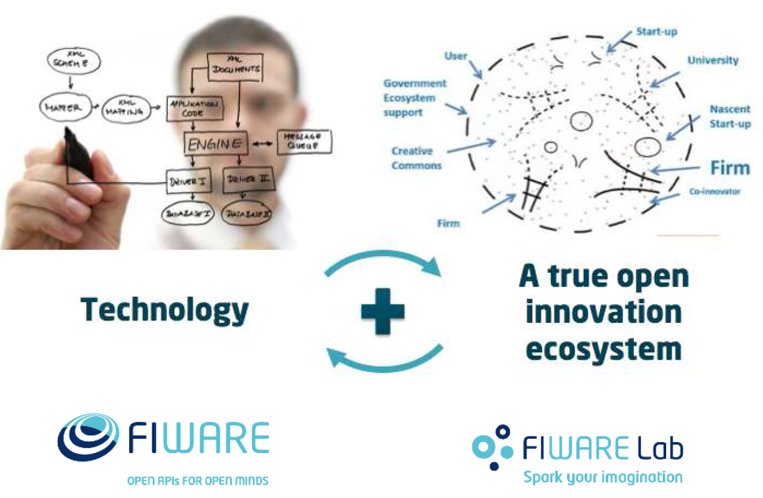
FIWARE Lab
A live and open instance of FIWARE available to developers for free experimentation
Offered to developers for free, they can experiment and deploy showcase using FIWARE technology and exploiting published open data

Slide 8
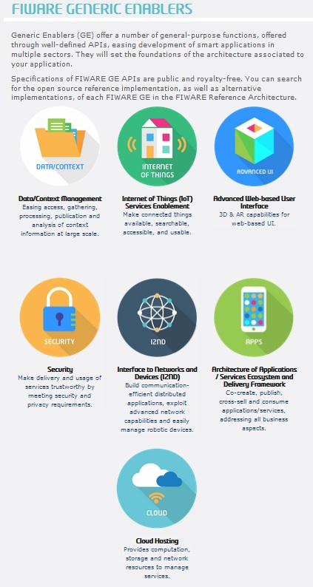



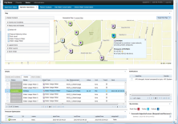




FIWARE major differential features
Cloud
Federation of infrastructures (private/public regions)
Data/Services Delivery
Complete Context Management Platform
IoT
Security
I2ND
Apps
Easy incorporation of advanced 3D and AR features
Security Monitoring
Advanced networking (SDN) and middleware
Automated GE deployment
Integration of Data and Media Content
Easy plug&play of devices using multiple protocols
Automated Measurements/Action ←→Context updates
Built-in Identity/Access/Privacy Management
Visual representation of context information
Visualization of data (operation dashboards)
Publication of data sets/services
Web UI
Interface to robots

Slide 9

Why is FIWARE relevant to Smart Cities?

Slide 10
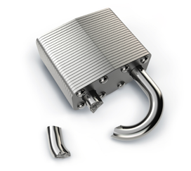

Why an open standard Smart City platform?
Avoiding vendor lock-in is nice …
  Standard Southbound APIs for sensor providers
  Standard Northbound APIs offered to applications
  Portability across platform providers
  Interoperability of apps on top of different providers
… but more relevant is to engage a larger community of developers
  True innovation
  More competition, leading to cost savings
Not any standard is enough
  Modularity (should not mean “take it all or nothing”)
  Allow different business models
  Non-intrusive, should live with the fact that many city service systems come from third parties with their own platform

Slide 11

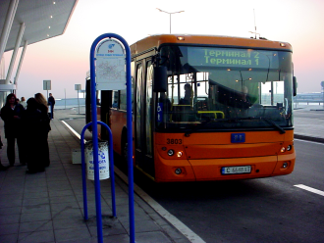
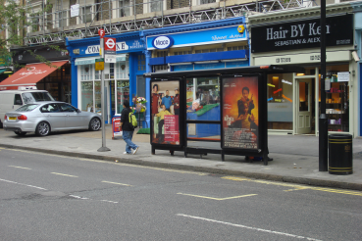
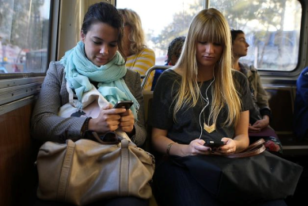
Being “Smart” requires first being “Aware”
Implementing a Smart City requires gathering and managing context information describing the current and historic “state” of the city
Context information refers to the values of attributes characterizing entities relevant to city services, governance and third-party apps
City Governance System
City Services
Third-party Apps
Context Information
Citizen
Name-Surname
Birthday
Preferences
Location
ToDo list
Bus
Location
No. passengers
Driver
Licence plate
Shop
Location
Business name
Franchise
offerings

Slide 12
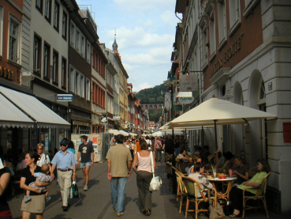
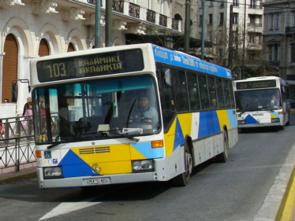

FIWARE NGSI: Context from different sources
Context information may come from many sources:
  Existing systems
  Users, through mobile apps
  Sensor networks
Source of info related to a given entity may vary over time
What’s the current temperature in place “X”?
NGSI API
Place = “X”, temperature = 30º
It’s too hot!
A sensor in a pedestrian street
The Public Bus Transport Management system
Someone from his smartphone

Slide 13
Context Management in FIWARE
The FIWARE Context Broker GE implements the OMA NGSI-9/10 API: a simple yet powerful standard API for managing Context information
The FIWARE NGSI API is Restful: any web/backend programmer gets quickly used to it
Application/Service
NGSI API
Context Broker
Citizen
Name-Surname
Birthday
Preferences
Location
ToDo list
Bus
Location
No. passengers
Driver
Licence plate
Shop
Location
Business name
Franchise
offerings

Slide 14
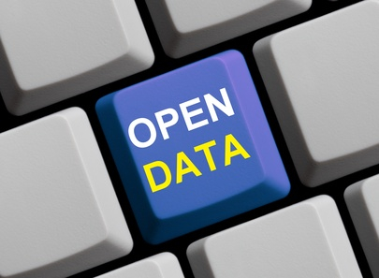
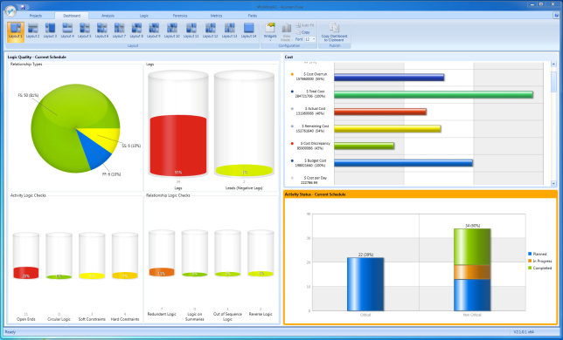
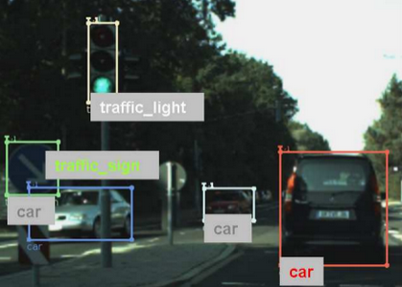

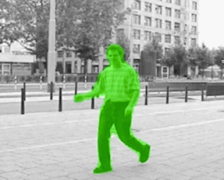
Once context information is gathered, a lot of useful complementary FIWARE enablers can be used
Advanced Web-based UI (AR, 3D)
Open data publication
Data/Apps visualization
Context Broker
Complex Event Processing
Multimedia processing
Big Data Analysis

Slide 15

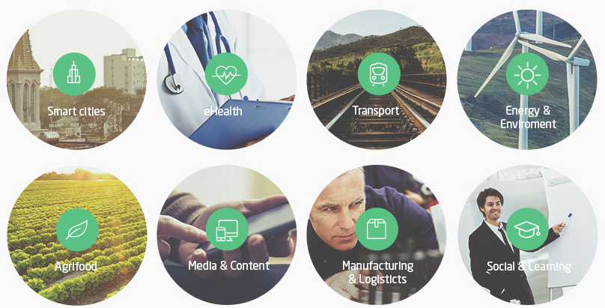
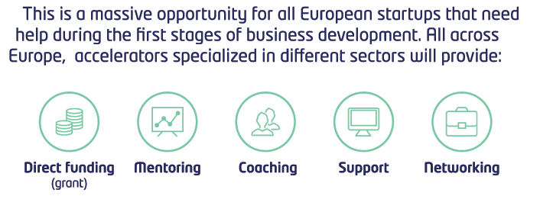
FIWARE Accelerate
A program that funds European smart communities, and ignites roll-out of the ecosystem

Slide 16



How can standard Smart City data models easing common solutions be defined?
The FIWARE Accelerator program enables to identify killer Smart City apps developed by entrepreneurs
  These applications can as basis for definition of a standard set of Smart City data models
  FIWARE resources would be devoted to help coordinating the data curation process
  Involvement in this process becomes also an incentive for the entrepreneurs to join the program (“I want to influence the standard so that my app can easily align with it”, “I want to provide one of the first example applications”)
  There are 80 M€ for entrepreneurs that can be put at work!
Cities connected to FIWARE Lab will play a key role:
  Their data models will be contrasted/analyzed against those coming from the apps and other cities
  They would get involved in the data curation process

Slide 17


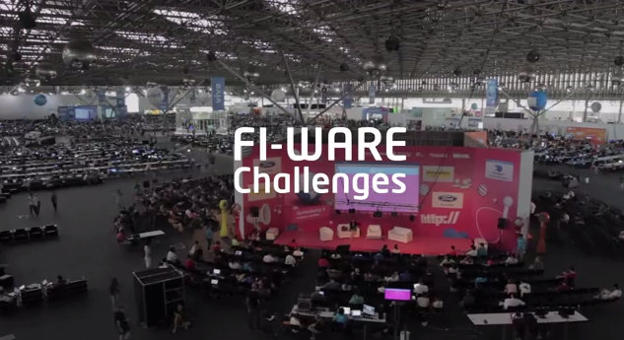
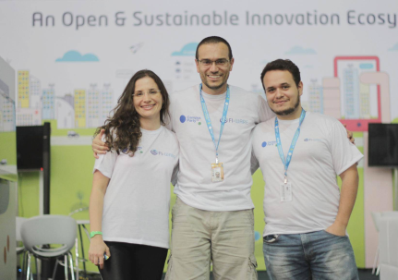
How the ecosystem is actually emerging: the case of Smart Cities
Some cities already connecting to FIWARE Lab:
  Italy: Trento, Torino, Veneto
  Spain: Valencia, Sevilla, Málaga, Santander, Logroño, Vigo, Lleida, Sabadell, …
  Finland: Helsinki, Espoo
  Netherlands: Amsterdam
  Portugal: Lisbon
  Ongoing discussion with other cities
FIWARE Challenge on Smart Cities:
  Launched end of October
  300+ teams (individuals, startups, SMEs – few researchers) applied to the challenge (ES, EN)
  20 final teams run the final in CPBR 14
  quite amazing results!

Slide 18
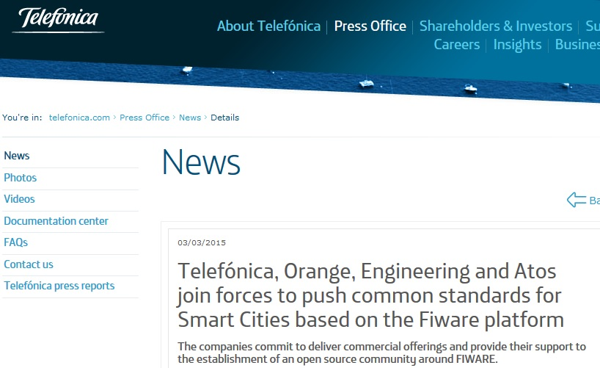
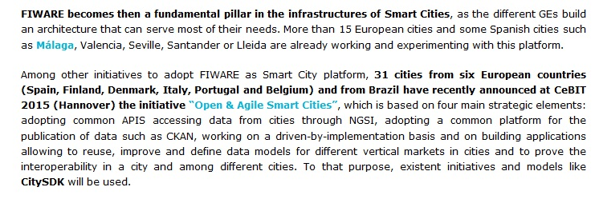
In addition…

Slide 19
Join us!
http://fiware.org
http://lab.fiware.org
Follow @Fiware on Twitter !
Check latest videos at www.youtube.com/user/FIWARE
18

Slide 20






FIWARE IoT & Context/Management altogether
Applications
CEP
BigData Analysis
Other sources
ContextBroker
IoT-enabled Context Management
Simple processing
FIWARE NGSI-9/10
NGSI IoT Agents
IoT Backend Device
Management
Backend
Backend
Native NGSI IoT Agent
Native NGSI IoT Agent
Gateway/Device Platform GEs
Gateway/Device Platform GEs
Gateway/Device Platform GEs
Gateway/Device Platform GEs

Slide 21
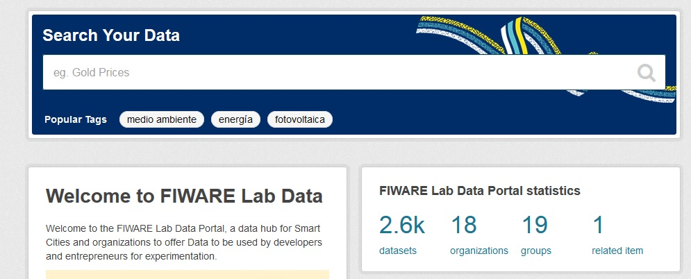

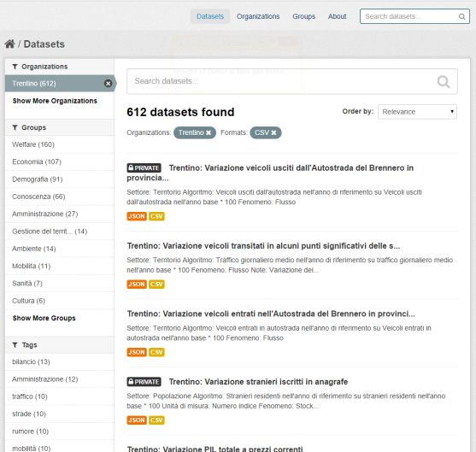
Open Data publication
NGSI
Context Broker
Context Sources
BigData Analysis

Slide 22

Why FIWARE
Driver | What is needed? | What does FIWARE bring?
Technology | Open, driven by implementation, specs (open source reference implemenation) Sustainable investment over time | Open specifications backed by open source reference implementations (see [1], [2]) 100+ M€ of investment (2011-2016)
Experimental environment | Ability to experiment with real data coming from cities (not just open historic datasets but real-time dat). Free Cloud capacity enabling entrepreneurs to test and host a permanent showcase of their applications. | 15 cities (7 in Spain) already working on setting up a connection to FIWARE Lab [3] 3000+ cores, 16Tb RAM and 750+ Tb HD will be the free computing capacity provided by the FIWARE Lab Cloud across 16 nodes distributed in Europe
Incentives for creating the ecosystem | Engagement of technology providers, entrepreneurs, data providers, customers Funding for first entrepreneurs joining the ecosystem. Invesment in promotion and dissemination activities | 52 partners, 13 countries (just FIWARE) 100 M€ devoted to fund entrepreneurs in 2014-2016. Additional opportunities in Horizon 2020. 6,2+ M€ devoted to dissemination
Global footprint | Helping entrepreneurs and technology providers to create opportunities not just in Europe but other regions (Latam, Asia and, why not, USA) | FIWARE Lab nodes in Mexico and Brazil. Conversations between EC and public authorities in Mexico and Brazil to explore collaboration opportunities
[1] – http://wiki.fi-ware.org/Summary_of_FIWARE_Open_Specifications
[2] – http://catalogue.fi-ware.org
[3] – http://lab.fi-ware.org

